Slide 1
Query Processing Part I
CS- 212
Distributed Database Systems
Ms. Mariam Nosheen
Computer Science Department, LCWU, Lhr

Slide 2
Outline of todays Presentation
Query Processing
Overview of Query Processing
Query Decomposition
Ms. Mariam Nosheen
CS- 212 Distributed Database Systems

Slide 3
Query Processing
Query Processing
Query processing in distributed context is to transform a high level query on a distributed database, which is seen as a single database by the users, into an efficient execution strategy expressed in a low-level language on local databases.
The main function of a relational query processor is to transform a high level query(typically, in relational calculus) into an equivalent lower-level query(typically, in some variation of relational algebra).
The main difficult is to select the execution strategy that minimizes resource consumption
The low level query actually implements the execution strategy for the query. The transformation must achieve both correctness and efficiency.
It is correct if low level query has the same semantics as the original query, that is, if both queries produce the same results.
The well defined mapping form relational calculus to relational algebra makes the correctness issue easy.
Ms. Mariam Nosheen
CS- 212 Distributed Database Systems

Slide 4
Query Processing Components
Query Processing
Query language that is used
➠ SQL: “intergalactic data speak”
Query execution methodology
➠ The steps that one goes through in executing high-level (declarative) user queries.
Query optimization
➠ How do we determine the “best” execution plan?
Ms. Mariam Nosheen
CS- 212 Distributed Database Systems

Slide 5
Query Processing Components
Query Processing
Ms. Mariam Nosheen
CS- 212 Distributed Database Systems

Slide 6
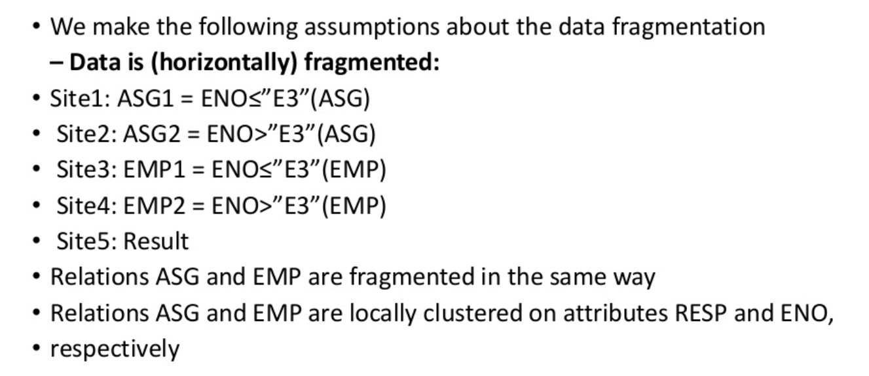
Query Processing Example
Query Processing
Ms. Mariam Nosheen
CS- 212 Distributed Database Systems

Slide 7
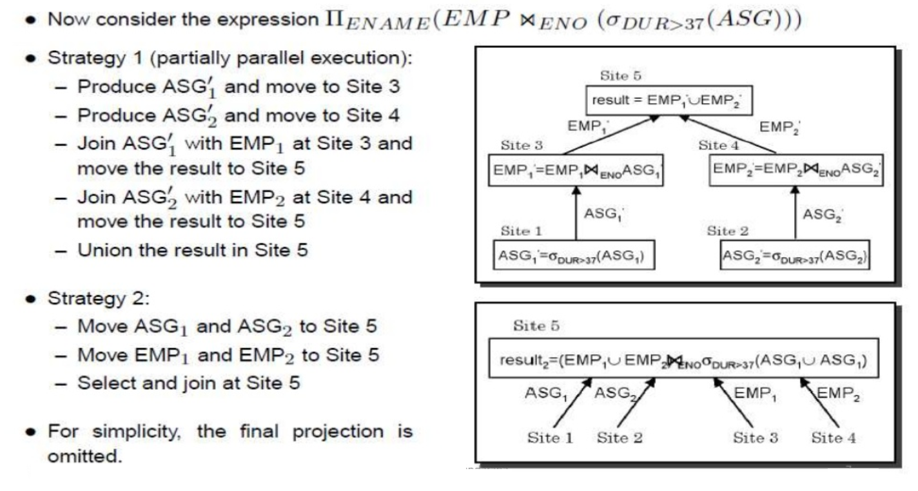
Query Processing Example
Query Processing
Ms. Mariam Nosheen
CS- 212 Distributed Database Systems

Slide 8
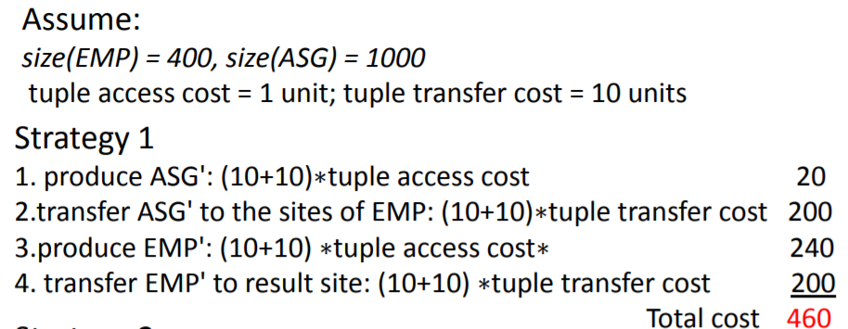
Cost of Alternatives
Query Processing
Ms. Mariam Nosheen
CS- 212 Distributed Database Systems

Slide 9
Cost of Alternatives
Query Processing
Ms. Mariam Nosheen
CS- 212 Distributed Database Systems

Slide 10
Query Optimization Objectives
Query Processing
Minimize a cost function
I/O cost + CPU cost + communication cost These might have different weights in different distributed environments
Wide area networks
➠ communication cost will dominate low bandwidth low speed high protocol overhead
➠ most algorithms ignore all other cost components
Local area networks
➠ communication cost not that dominant
➠ total cost function should be considered Can also maximize throughput
Ms. Mariam Nosheen
CS- 212 Distributed Database Systems

Slide 11
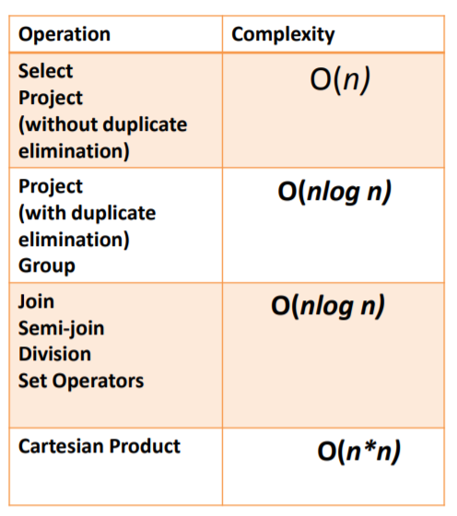
Complexity of Relational Operations
Query Processing
Assume
➠ relations of cardinality n
➠ sequential scan
Ms. Mariam Nosheen
CS- 212 Distributed Database Systems

Slide 12
Query Optimization Issues – Types of Optimizers
Query Processing
Exhaustive search
➠ cost-based
➠ optimal
➠ combinatorial complexity in the number of relations
Heuristics
➠ not optimal
➠ regroup common sub-expressions
➠ perform selection, projection first
➠ replace a join by a series of semijoins
➠ reorder operations to reduce intermediate relation size
➠ optimize individual operations
Ms. Mariam Nosheen
CS- 212 Distributed Database Systems

Slide 13
Query Optimization Issues – Optimization Timings
Query Processing
Static
➠ compilation optimize prior to the execution
➠ difficult to estimate the size of the intermediate results error propagation
➠ can amortize over many executions
➠ R*
Dynamic
➠ run time optimization
➠ exact information on the intermediate relation sizes
➠ have to reoptimize for multiple executions
➠ Distributed INGRES
Hybrid
➠ compile using a static algorithm
➠ if the error in estimate sizes > threshold, reoptimize at run time
➠ MERMAID
Ms. Mariam Nosheen
CS- 212 Distributed Database Systems

Slide 14
Query Optimization Issues – Statistics
Query Processing
Relation
➠ cardinality
➠ size of a tuple
➠ fraction of tuples participating in a join with another relation
Attribute
➠ cardinality of domain
➠ actual number of distinct values
Common assumptions
➠ independence between different attribute values
➠ uniform distribution of attribute values within their domain
Ms. Mariam Nosheen
CS- 212 Distributed Database Systems

Slide 15
Query Optimization Issues –Decision Sites
Query Processing
Centralized
➠ single site determines the “best” schedule
➠ simple
➠ need knowledge about the entire distributed database
Distributed
➠ cooperation among sites to determine the schedule
➠ need only local information
➠ cost of cooperation
Hybrid
➠ one site determines the global schedule
➠ each site optimizes the local subqueries
Ms. Mariam Nosheen
CS- 212 Distributed Database Systems

Slide 16
Query Optimization Issues –Network Topology
Query Processing
Wide area networks (WAN) – point-to-point
➠ characteristics
low bandwidth
low speed
high protocol overhead
➠ communication cost will dominate; ignore all other cost factors
➠ global schedule to minimize communication cost
➠ local schedules according to centralized query optimization
Local area networks (LAN)
➠ communication cost not that dominant
➠ total cost function should be considered
➠ broadcasting can be exploited (joins)
➠ special algorithms exist for star networks
Ms. Mariam Nosheen
CS- 212 Distributed Database Systems

